Slide 1

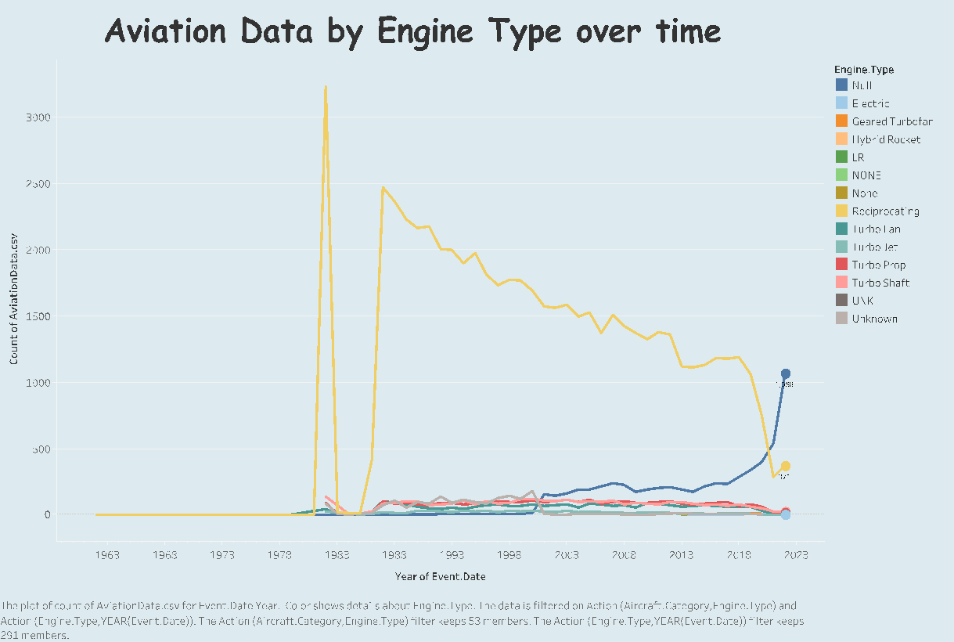
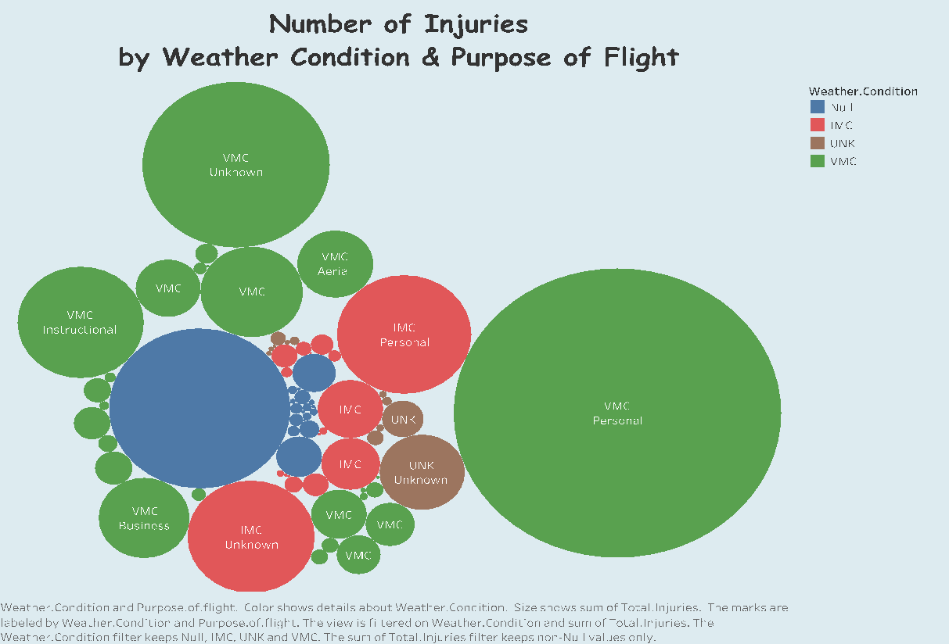
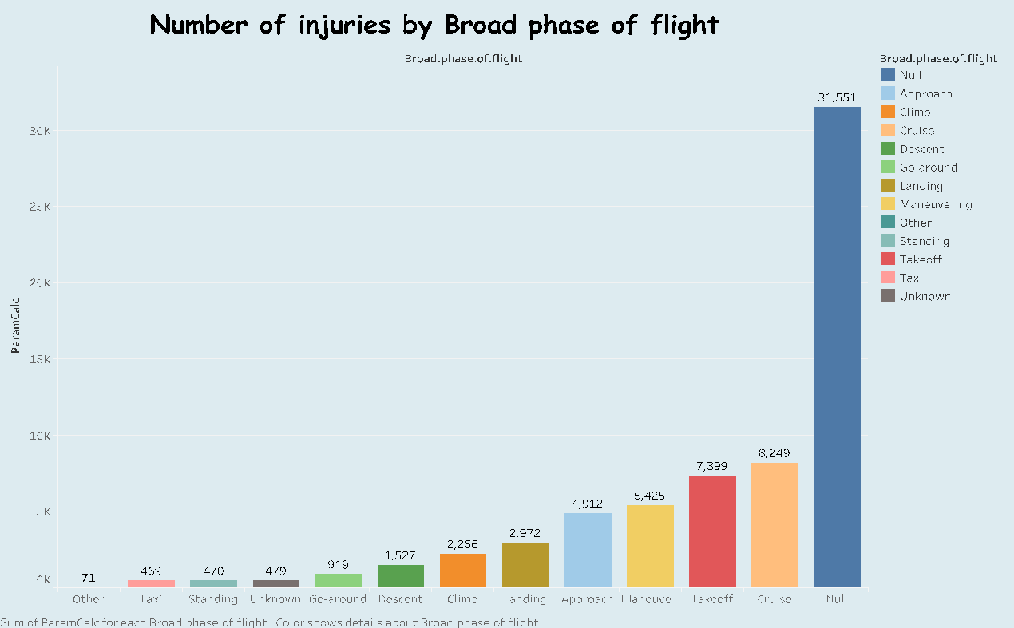
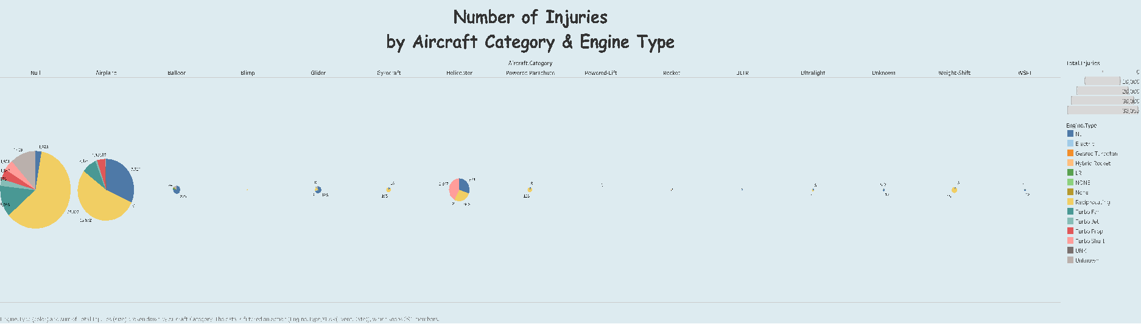
CIVIL AVIATION ACCIDENTS
(1962-2023)
Ngoc Oanh Nguyen
Civil Aviation Accidents_Tableau Public site
BUSINESS PROBLEM
Air travel is one of the most popular methods of transportation in the world, particularly for passengers traveling long distances. It is considered as the safest the safest means of transportation in which a person can engage.
“Aviation accidents” are not solely confined to planes crashing. This category includes other aircraft such as helicopters, ultra-lights, gliders, etc. According to statistical reviews from the National Transportation Safety Board (NTSB), plane crashes and other aviation accidents have steadily decreased since 2001. The total number of U.S. general aviation accidents went from 1,728 to 1,085 in 2020. There were only five fatal accidents among 32.2 million flights in 2022.
While trends of risk of flying seem to be continuing downward steadily to exceptionally low level, that does not mean it is risk-free. The injuries and number of fatalities resulting from aviation accidents unfortunately tend to be far greater than other means of transportation.
Using statistics to identify the root cause of these aviation accidents can help prevent more in the future. Therefore, in this project, I will use the Aviation Accident Database & Synopses up to 2023 to careful analysis of the trends that are emerging to improve the quality and safety of traveling by airplane.
THE BUBBLE CHART
Correlation – weather conditions & purpose of flight
VMC – Visual Meteorological Conditions - sufficient visibility & maintain visual separation – good.
IMC – Instrument Meteorological Conditions – require the use of instruments – cloudy or low visibility.
The biggest bubble is VMC-Personal, which means most injuries is from personal flight purpose, typically traveling on a commercial plane, in good condition.
Additionally, there are a lot of green bubbles, which indicates that airplane accidents are not totally due to the weather but other reasons. However, bad weather could increase the number of injuries to some extent.
AVIATION DATA BY ENGINE TYPE
Show how the number of injured people changes over time.
The reciprocating engine accounted for the largest number of crashed aircraft
The most common engine in civil aircraft during the study period.
Difficult to conclude that there are more bugs happening inside this engine than other types.
CHART HERE
PARAMETER CHART
The number of people injured based on each phase of flight can vary the measure of severity such as fatal, serious, minor, and uninjured.
Null phase – always the highest of all measures – difficult to collect information about plane crashes
So catastrophic - black box cannot be found.
The takeoff, maneuvering, and cruise phases – cause the most serious damage to human life
→ Pilots, mechanical engineers, logistics staff – improve technology & equipment – minimize problems that can occur in the air in order to avoid accidents.
MAP – INJURIES BY COUNTRY
Mainly in the USA & surrounding areas
Disproportionate
DATA
Aviation Accident Database & Synopses – Kaggle (Dataset Link)
NTSB aviation accident database – from 1962 and later about civil aviation accidents and selected incidents within the United States, its territories, and possessions, and in international waters.
Useful for researchers, aviation engineers, and others interested in identifying the root cause of these accidents can help prevent more for future.
3 W QUESTIONS
What Went Well
Clean dataset – facilitate manipulate the dataset.
Rich in features and visualizations.
Detailed tutorials.
What Did NOT go Well
Finding a dataset – not easy & time-consuming.
A lot of missing data & confusingly classified attributes.
Many string attributes – difficult to illustrate with other metrics.
Not many numeric attributes – difficult to display on the graph.
Aviation accidents count.
Total of injuries - fatal, serious, minor, uninjured.
What Would I do Differently Next Time
Spend more time finding the data.
Carefully consider the amount of numeric data – perform calculations & visualize the data.
Try a different larger dataset
Try different visualization tools – Grafana/FusionCharts.

